Slide 1
Alternative Indicators of Well-Being for Melanesia
Definition: Well-being = Quality of Life = Welfare = Happiness (≠ Money)
Changing the way progress is measured in the South Pacific
Malvatumauri National Council of Chiefs
Vanuatu National Statistics Office

Slide 2
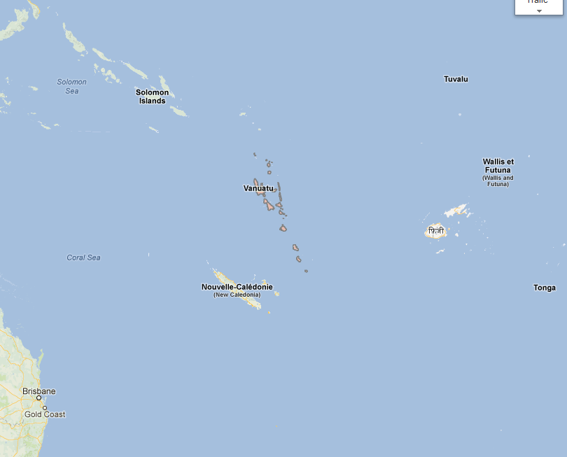

Slide 3
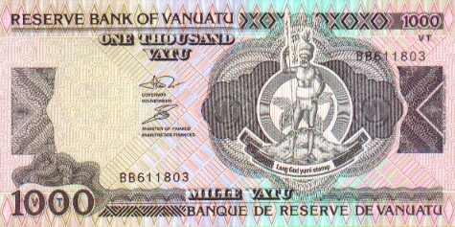
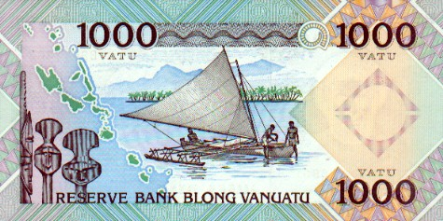
Vanuatu’s cash and Traditional economies
A well-being reality check

Slide 4
Vanuatu’s Cash Economy
Vanuatu is a “Least Developed Country” (LDC) – The United Nations classification of the world’s most impoverished 50 countries
Low Gross National Income (GNI)
Weak human assets
High degree of economic vulnerability

Slide 5
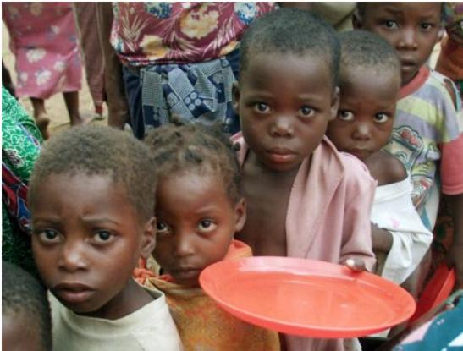
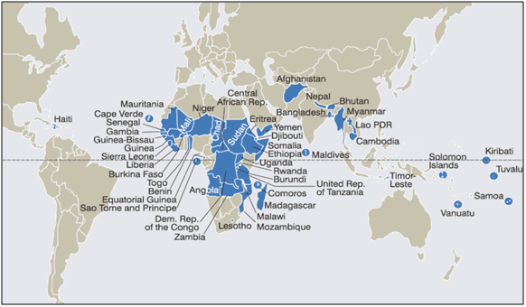
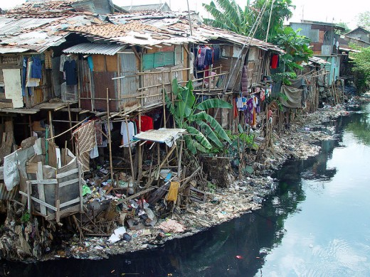
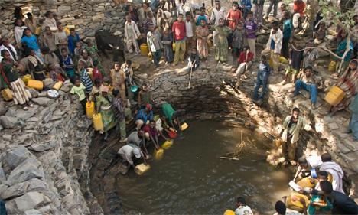
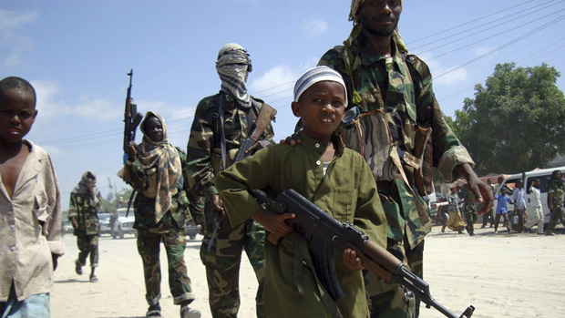
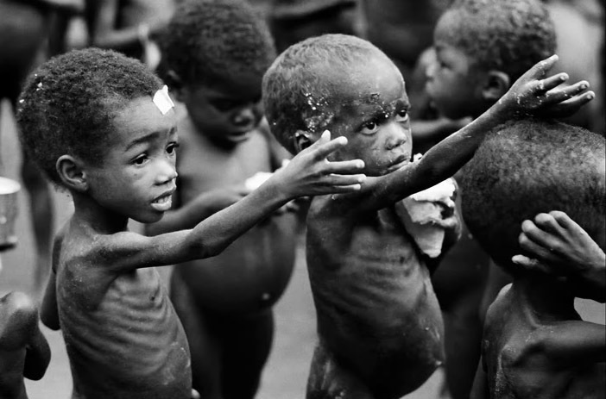
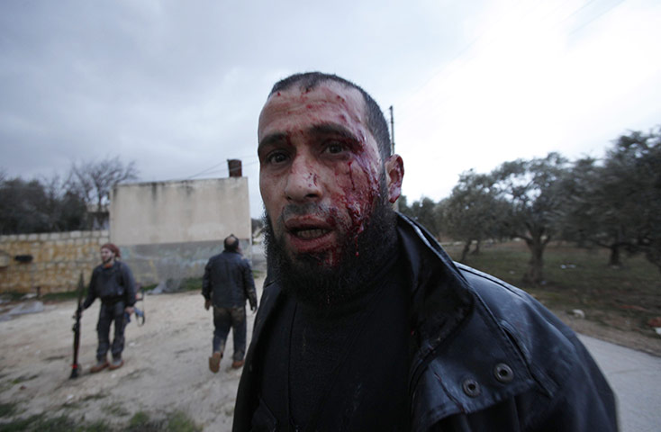
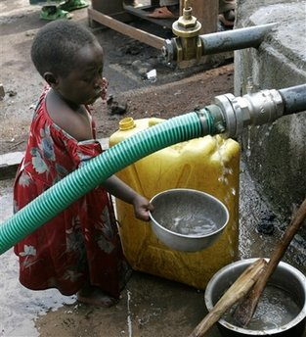
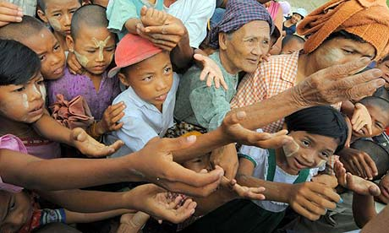

Slide 6
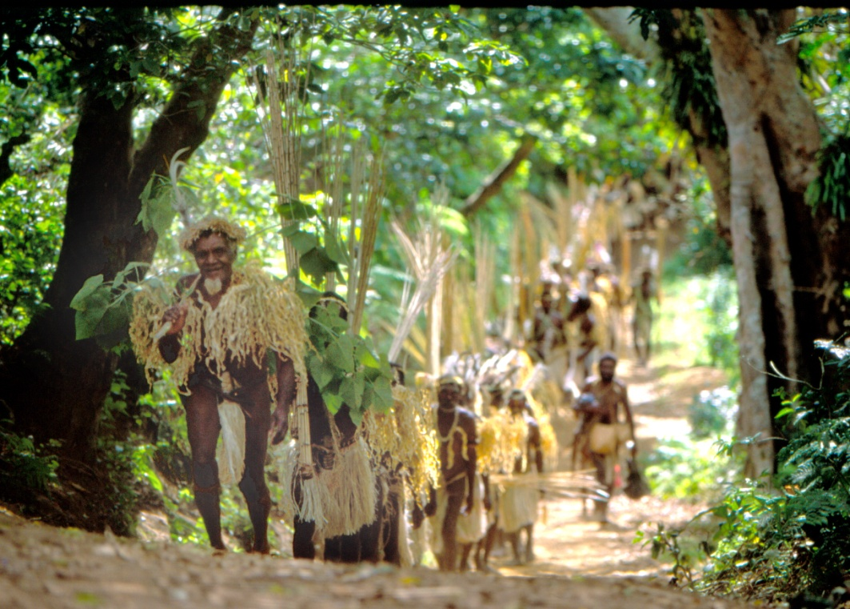
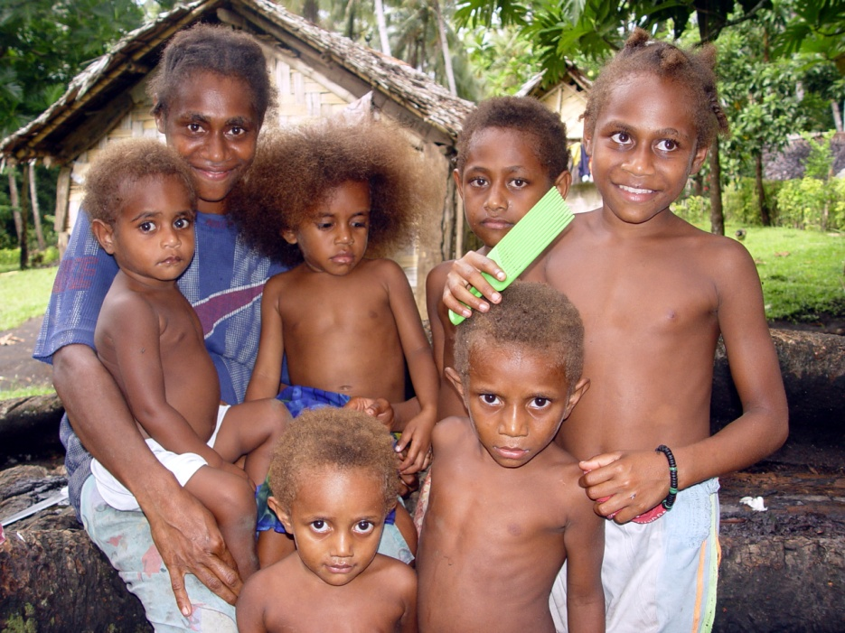
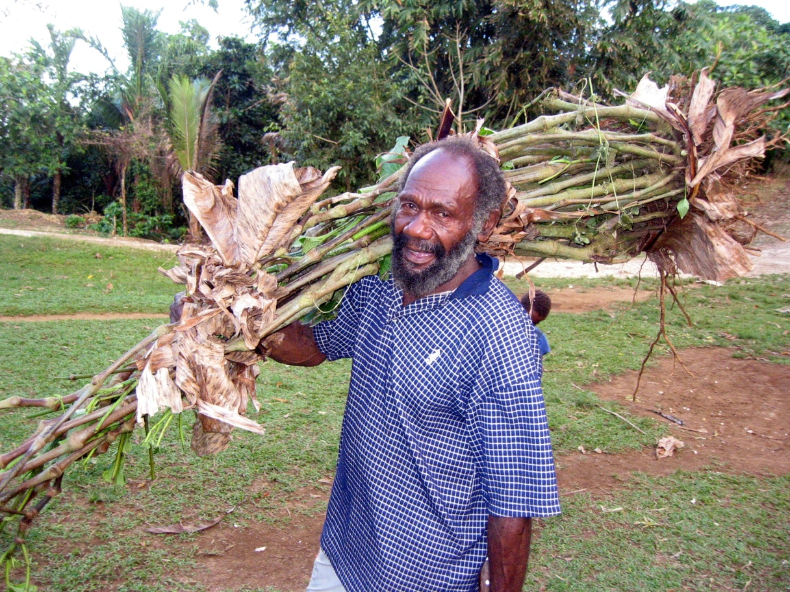
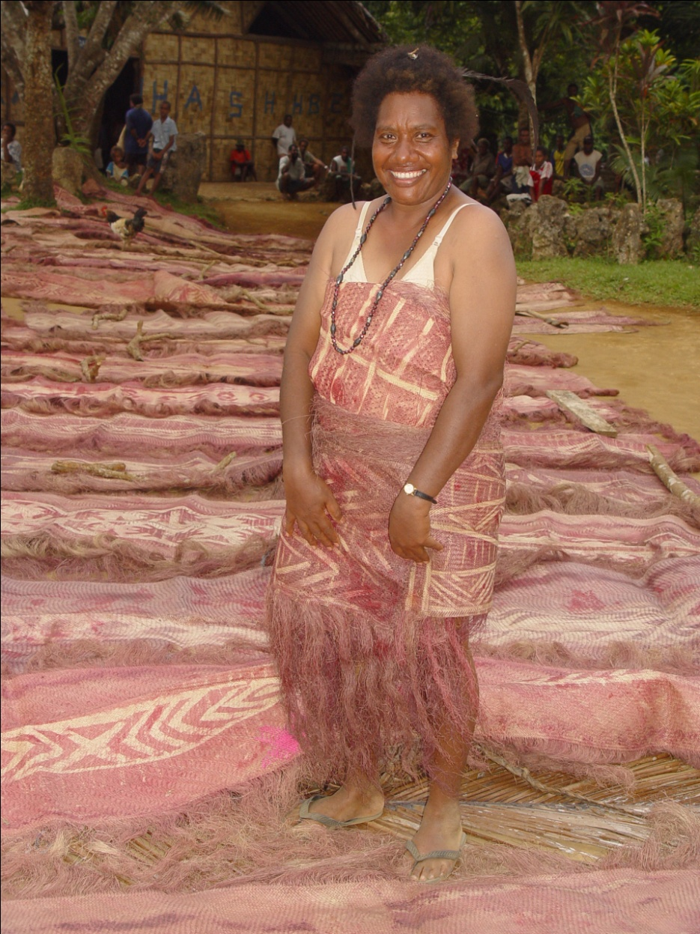
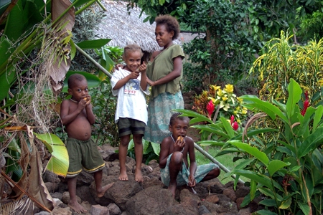
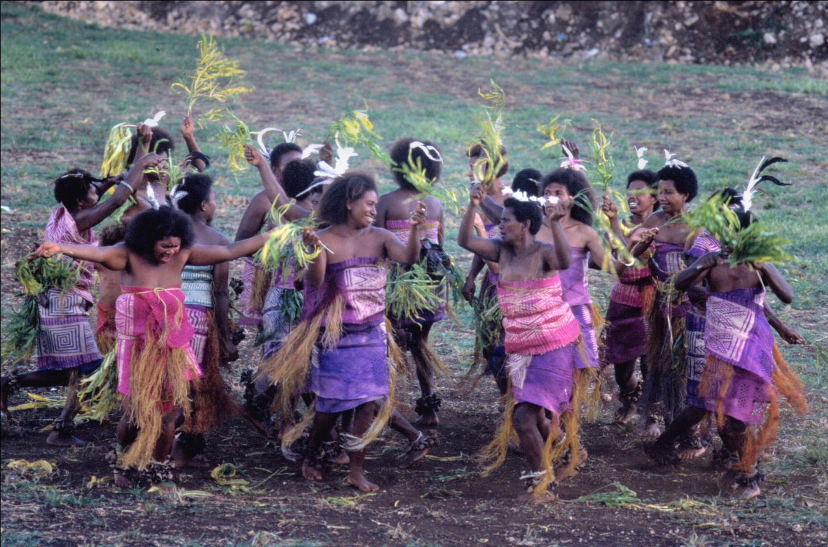
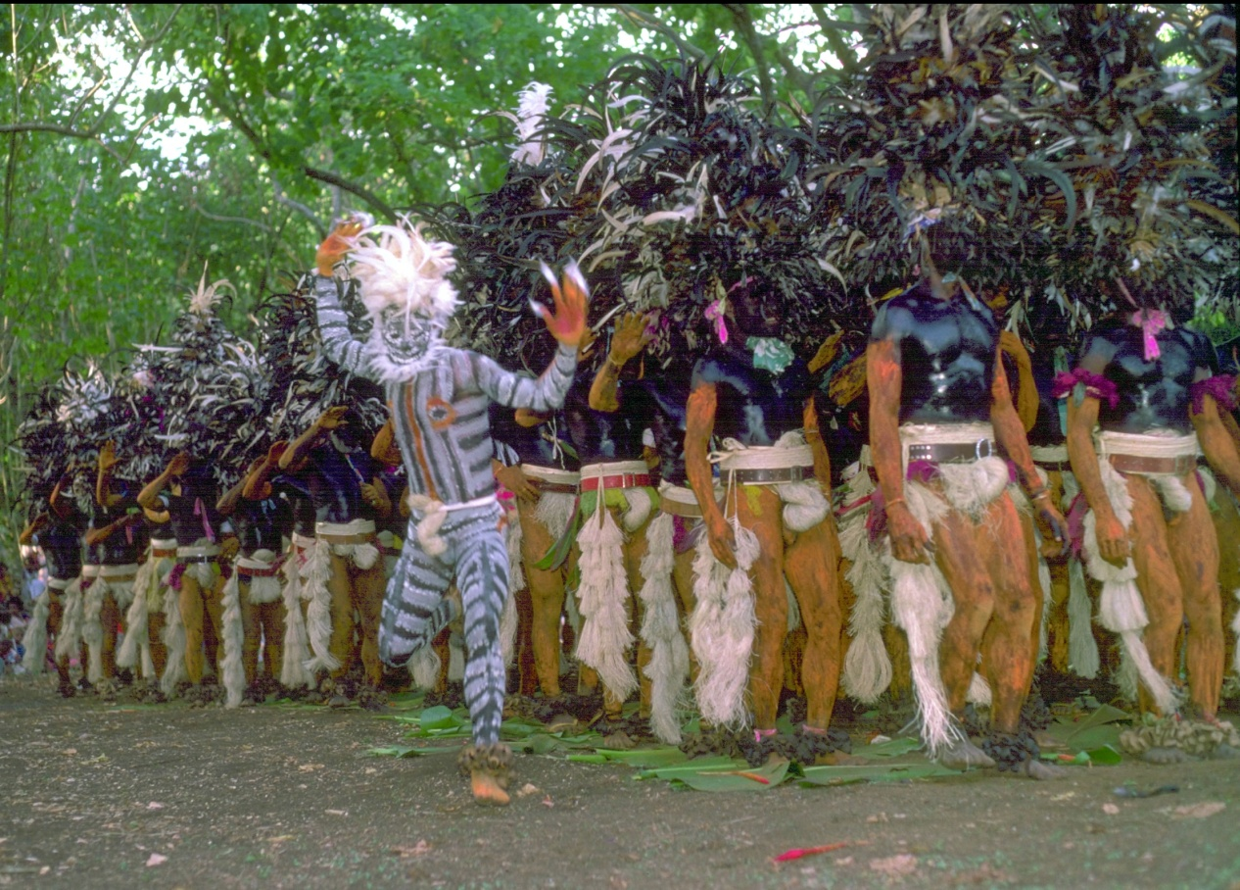
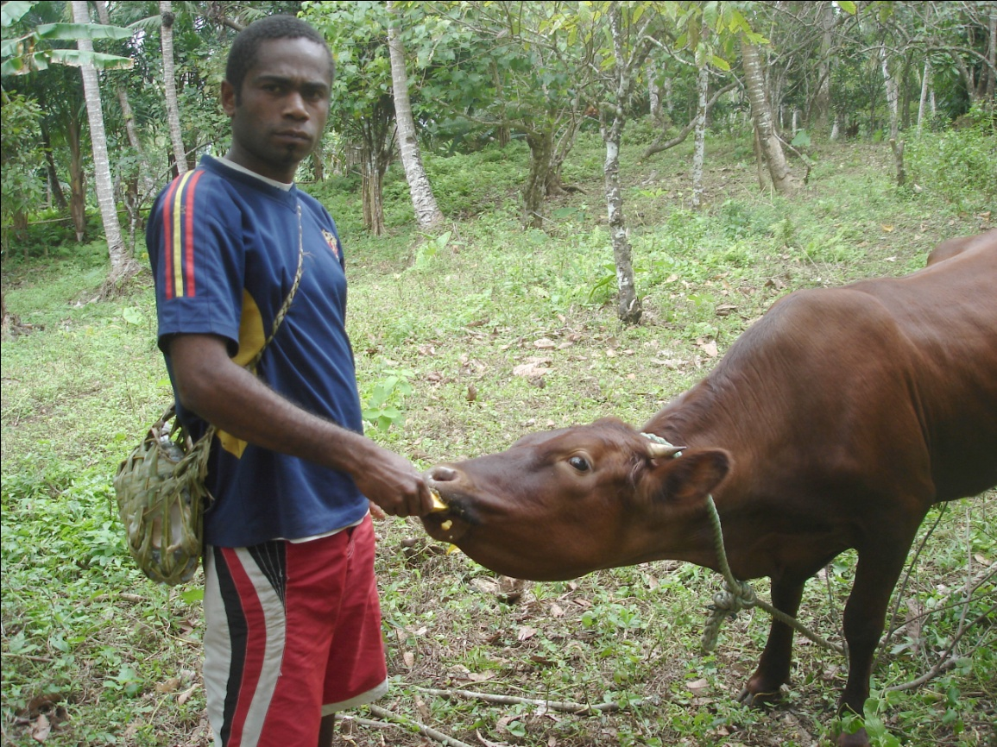
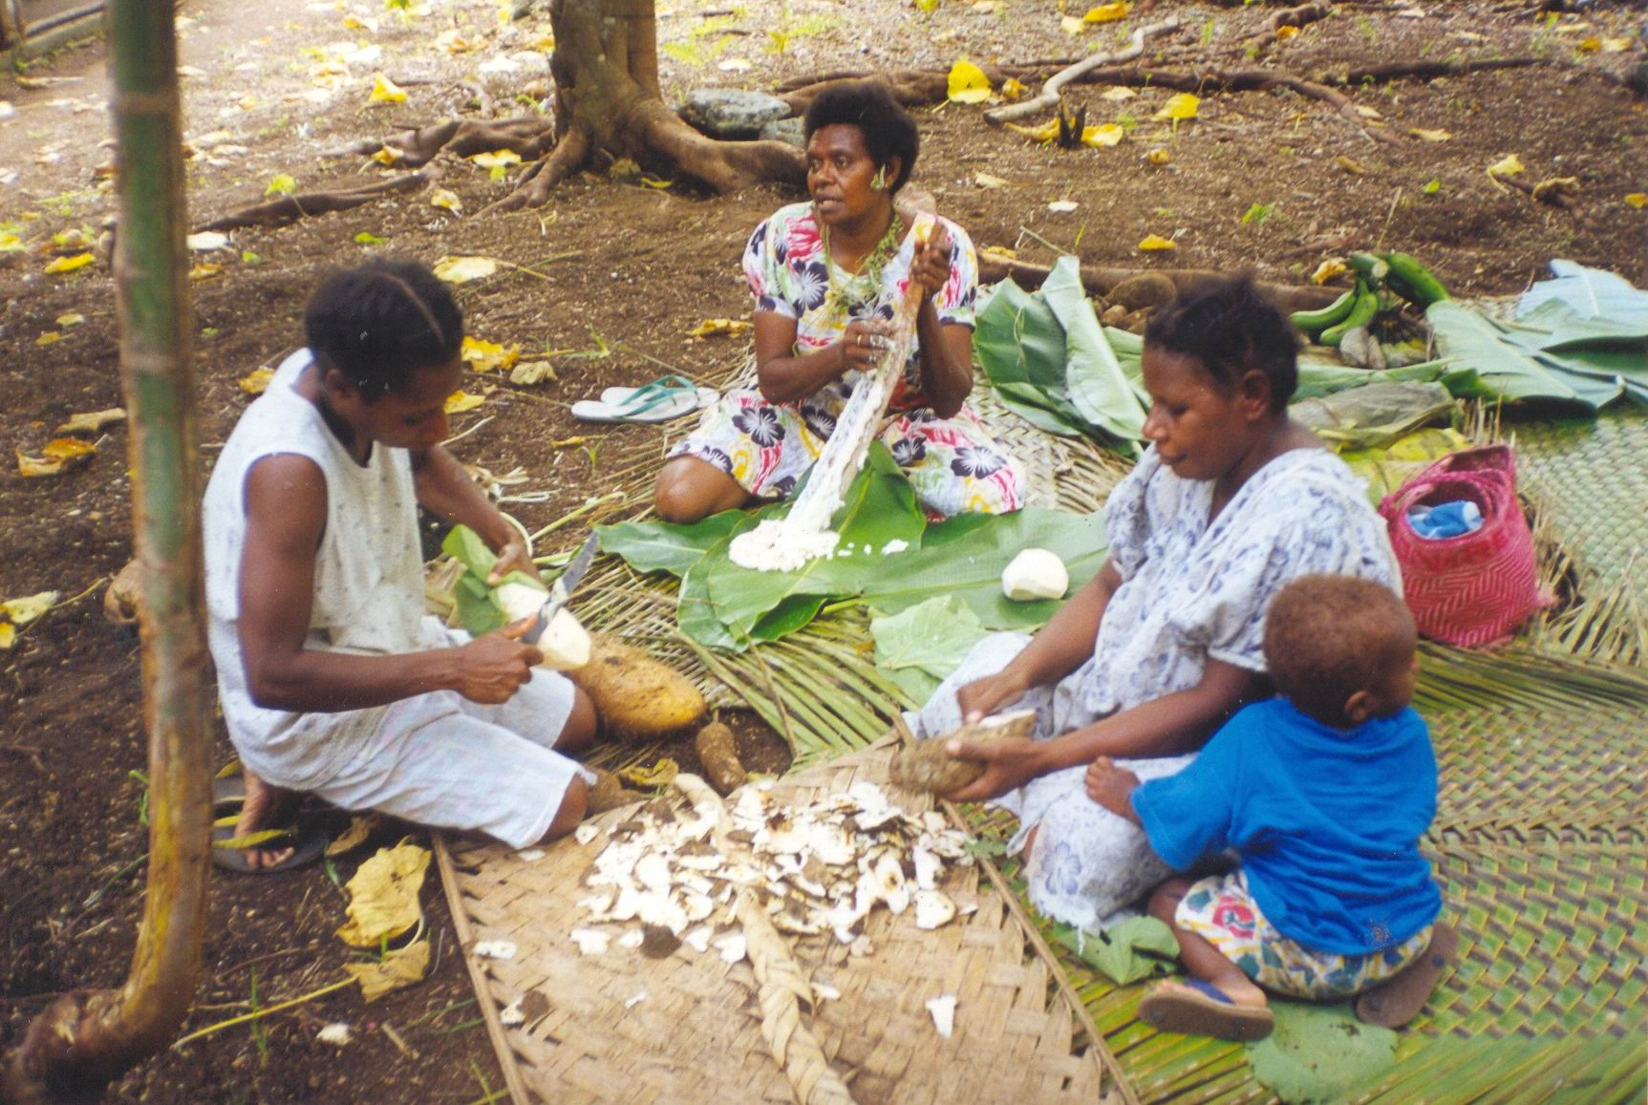
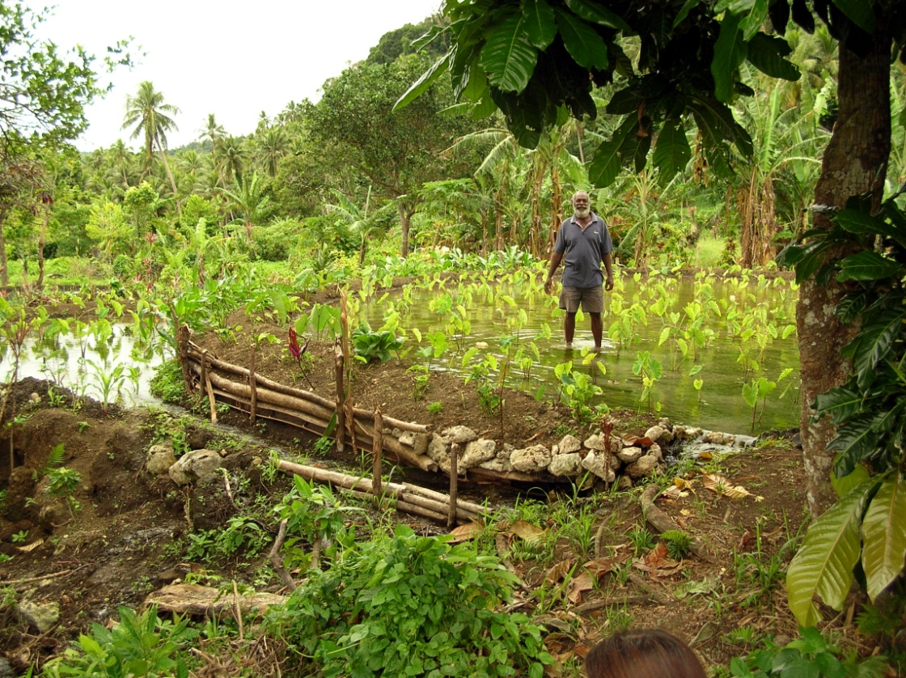
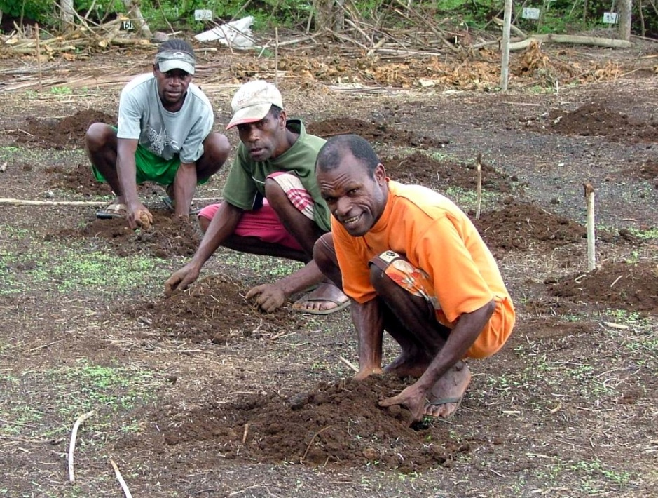

Slide 7
Vanuatu’s traditional economy
The vast majority of ni-Vanuatu are supported primarily by a rich traditional economy, referring to the systems with which society manages resources and provides livelihoods for its people.
The traditional economy provides the majority of ni-Vanuatu with food security, social security, and cultural identity.
The ways the traditional economy support ni-Vanuatu, and ways in which it interacts with the cash economy, have until now gone unstudied

Slide 8
“WE the people of Vanuatu,
PROUD of our struggle for freedom,
DETERMINED to safeguard the achievements of this struggle,
CHERISHING our ethnic, linguistic and cultural diversity,
MINDFUL at the same time of our common destiny,
HEREBY proclaim the establishment of the united and free Republic of Vanuatu
founded on traditional Melanesian values, faith in God, and Christian principles,
AND for this purpose give ourselves this Constitution.”
-Preamble, Constitution of Vanuatu

Slide 9
Alternative indicators of well-being
An attempt at measuring the traditional economy

Slide 10
Access to customary lands

Slide 11
Use of land for housing and agriculture

Slide 12
Perception of accessible land size

Slide 13
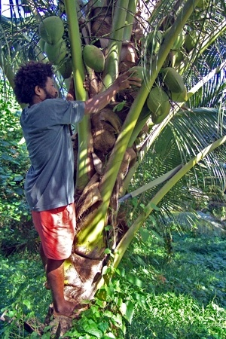
Access to forest resources

Slide 14
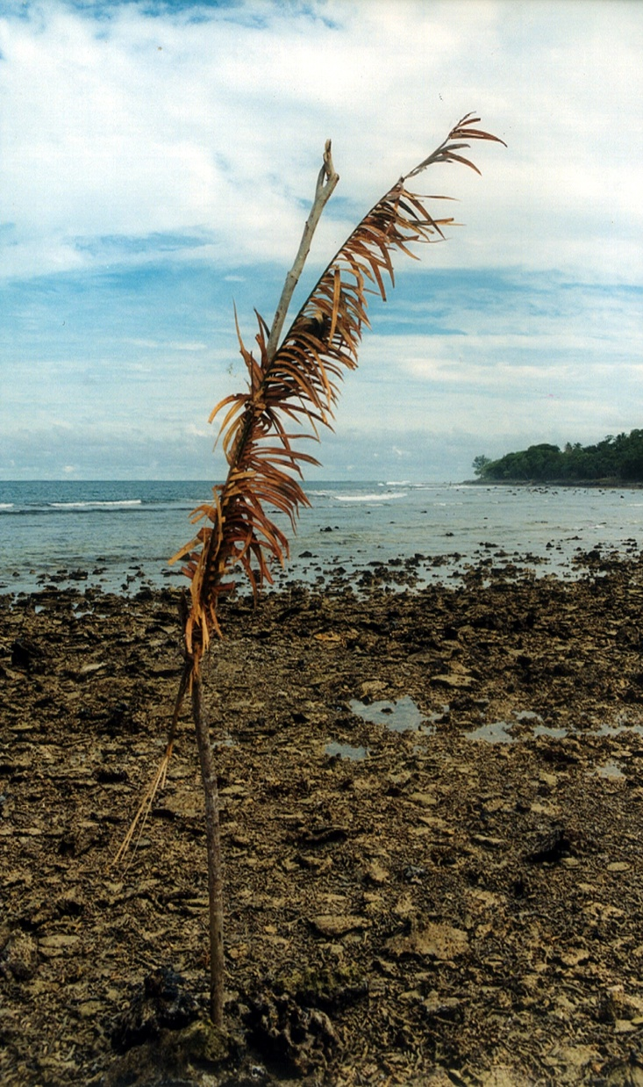
Access to Marine resources

Slide 15
Subjective Well-being

Slide 16
Language

Slide 17
Traditional Knowledge

Slide 18
Traditional Skills

Slide 19
Access to traditional wealth items

Slide 20
Perception of importance in participation in traditional activities

Slide 21
Subjective Well-being

Slide 22
DICTIONARY
economy
[ih – kon – uh –mee]
-noun
the management of the resources of a community, country, etc., especially with a view to its productivity.

Slide 23
Subjective Well-being

Slide 24
Subjective Well-being

Slide 25
Policy Relevance
The value-added of such indicators

Slide 26
Value-Added
“…the increasing access to and reliance on the cash economy brings opportunities but also vulnerability to economic crises and challenges for families to meet basic needs”.
Prioritized Action Agenda (PAA) – Reviewed 2011

Slide 27
Value-Added
MDGs should be adapted by governments to fit their circumstances, according to the United Nations
MDG #1: Eradicate Extreme Poverty and Hunger
In Vanuatu, the study shows that individuals/households with access to customary lands and traditional skills to utilize the productive capacity of lands are able to meet their basic needs. Access and skills should therefore be adopted as an additional indicator of MDG1

Slide 28
Value-Added
Other areas of PAA to benefit from these alternative indicators include:
National Strategic Priority 3: Good Governance and Public Sector Reform
PO 3.2 – Strategy 3.2.2, Strategy 3.2.6
PO 3.2 – Strategy 3.2.4
National Strategic Priority 4: Primary Sector Development, Climate Change, and Disaster Risk Management
PO 4.1 – Strategy 4.1.8
PO 4.5 – Strategy 4.5.1

Slide 29
ValuE-Added
Areas within PAA that should be expanded to acknowledge traditional contributions:
National Strategic Priority 5: Provision of Better Health Services, especially in rural areas
Accessibility of traditional medicines should be considered
National Strategic Priority 6: Education and Human Resource Development
Indicators of traditional knowledge and wisdom should be considered

Slide 30
Official Report information
The PDF version of the analysis report of both the studies on individual well-being and rural community well-being is available for download through the Vanuatu National Statistics Office website at www.vnso.gov.vu
Database is available to the public online through Secretariat for the Pacific Community
The documentary (English subtitles) available through Youtube under search term “Well-being in Vanuatu”
A process of vetting the indicators used for the pilot will begin next year

Slide 31
Je vous remercie tous d’etre venus et pour votre attention et patience avec ma presentation en anglais aujourd’hui.

